Slide 1
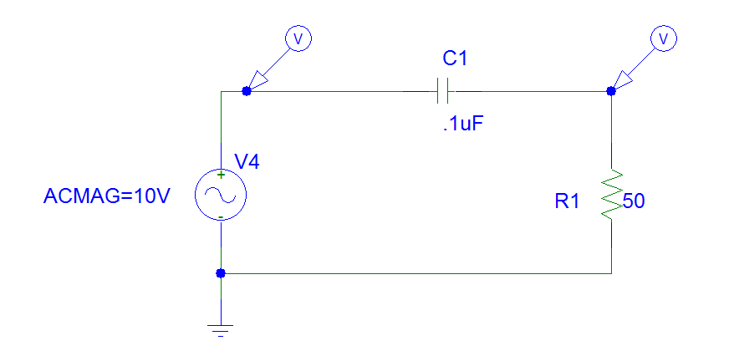
Test-1 Aim: Analyse freq. response of Single-ended HPF with Single-ended Input and Output

Slide 2
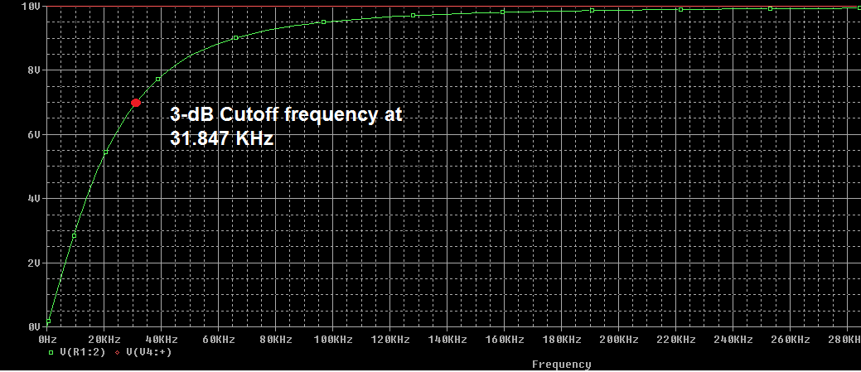
Simulation results after AC analysis of Test setup - 1

Slide 3
Observations from Spectrogram of Test setup - 1

Slide 4
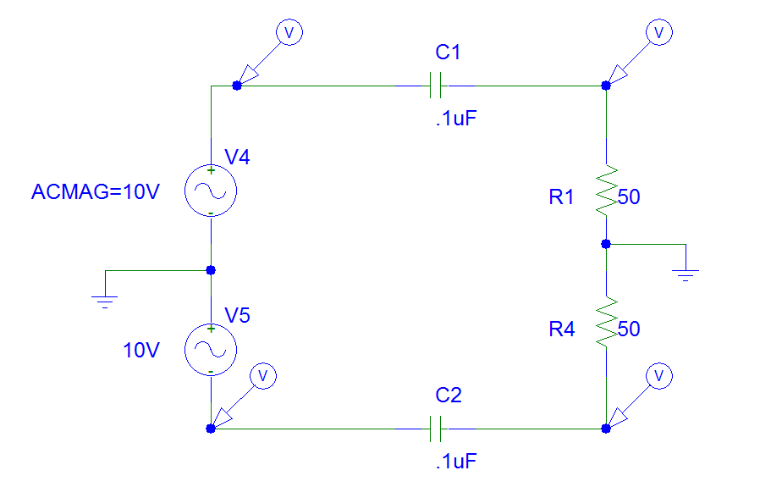
Test-2 Aim: Analyse freq. response of Differential HPF with Differential Input and Differential Output

Slide 5
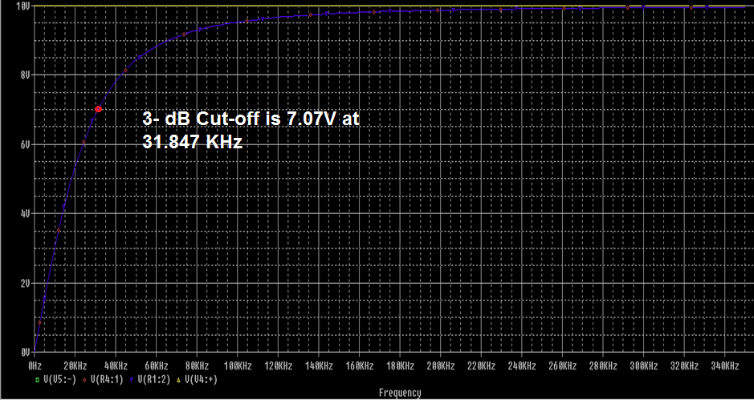
Simulation results after AC analysis of Test setup - 2

Slide 6
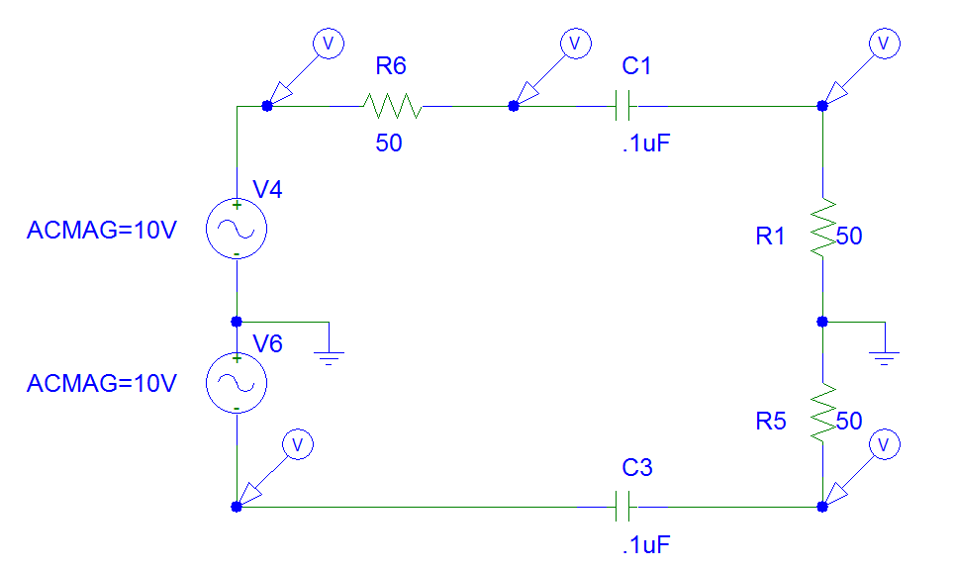
Test-3 Aim: Analyse freq. response of Differential HPF with Differential Input and Differential Output

Slide 7
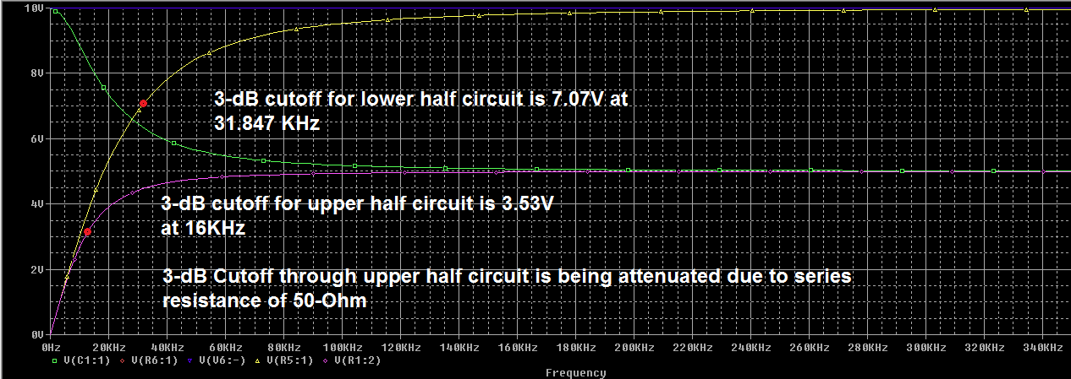
Simulation results after AC analysis of Test setup - 3

Slide 8
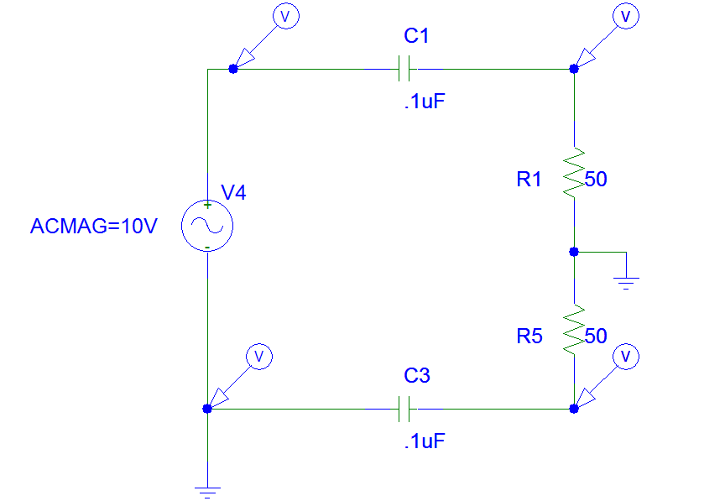
Test-4 Aim: Analyse freq. response of Differential HPF with Single-ended Input and Differential Output

Slide 9
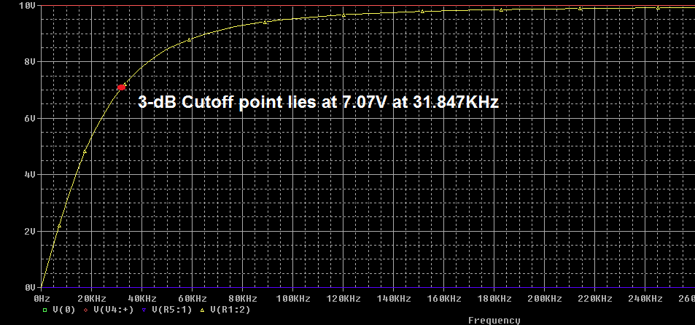
Simulation results after AC analysis of Test setup - 4

Slide 10
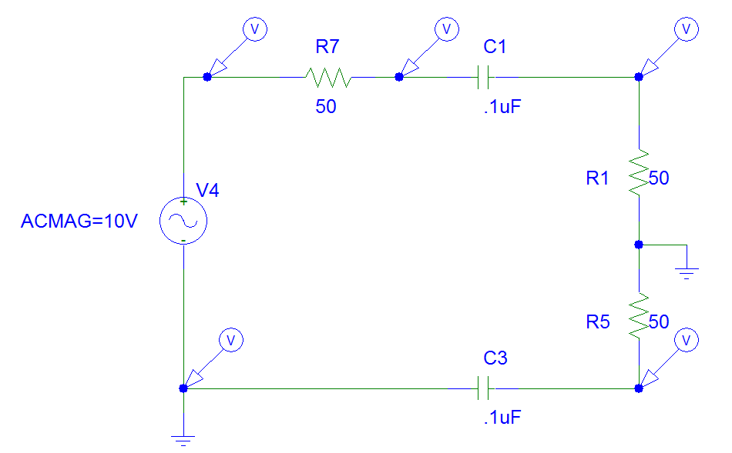
Test-5 Aim: Analyse freq. response of Differential HPF with Single-ended Input with series impedance of 50-Ohm and Differential Output

Slide 11
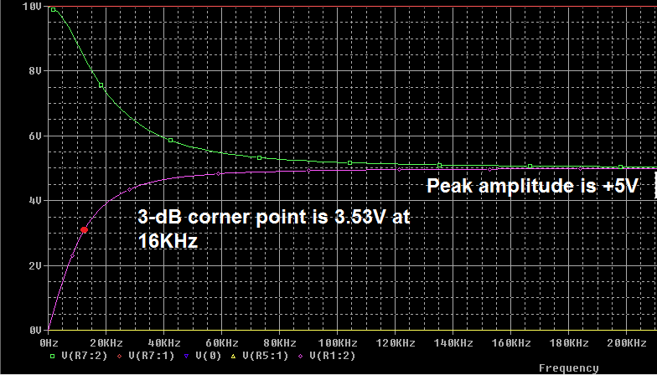
Simulation results after AC analysis of Test setup - 5

Slide 12
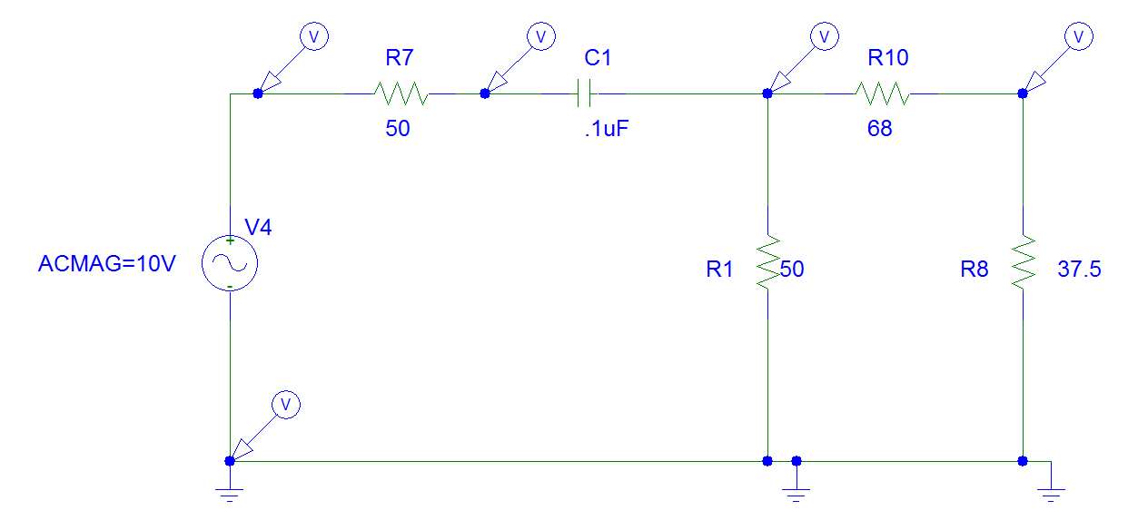
Test-6 Aim: Analyse freq. response of Single-ended HPF with Single-ended Input, series impedance of 50-Ohm and Differential Output with a resistive-pi network

Slide 13
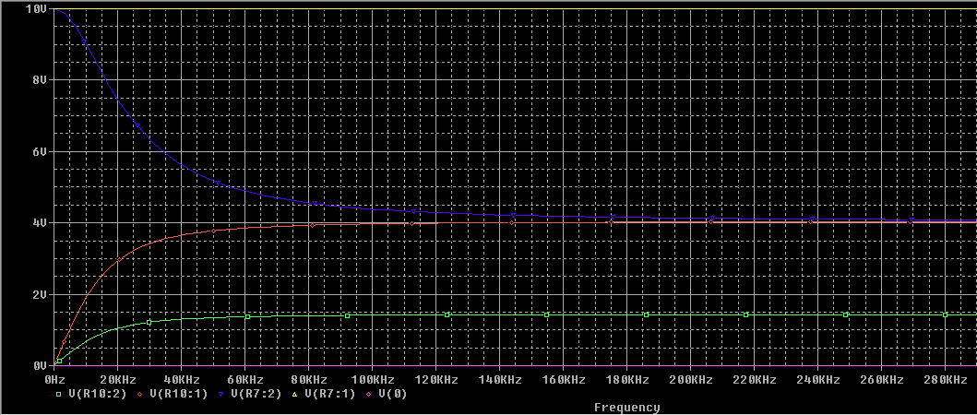
Simulation results after AC analysis of Test setup - 6

Slide 14
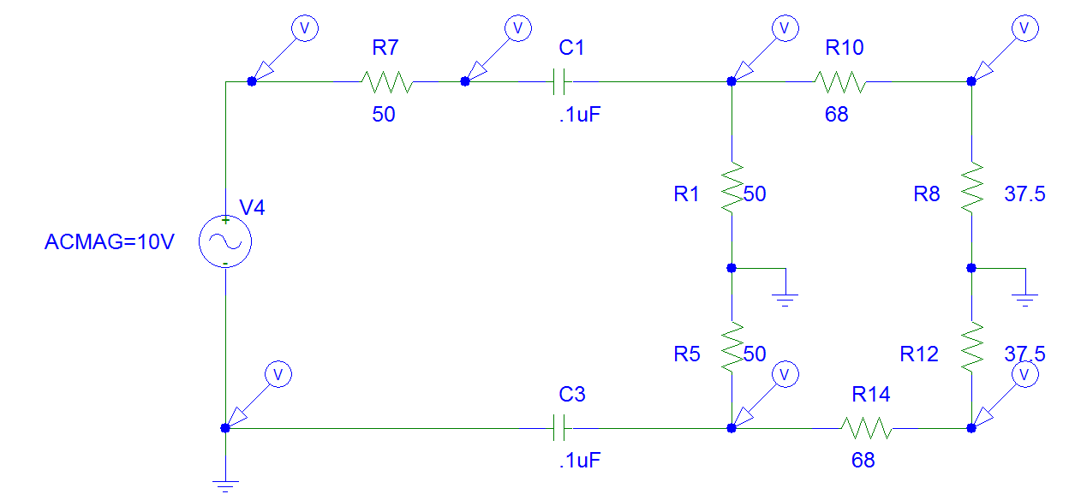
Test-7 Aim: Analyse freq. response of Differential HPF with Single-ended Input, series impedance of 50-Ohm and Differential Output with a resistive-pi network

Slide 15
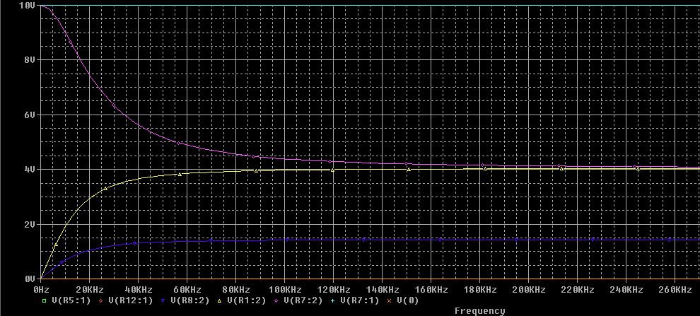
Simulation results after AC analysis of Test setup - 7

Slide 16
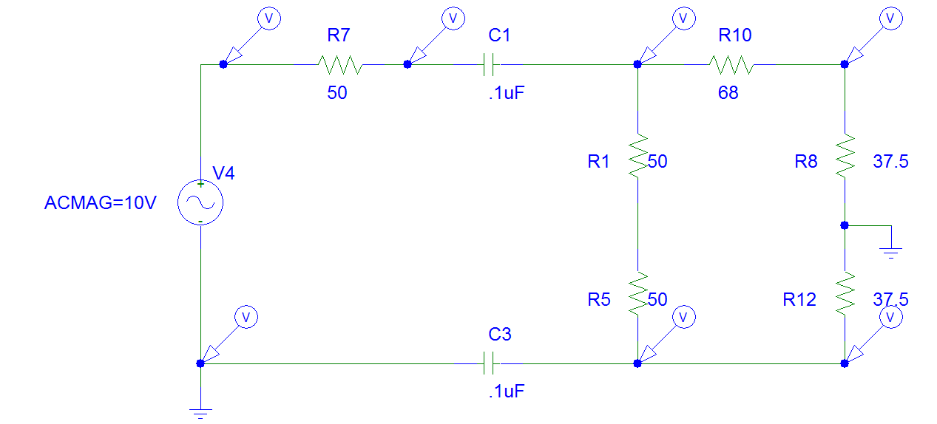
Test-8 Aim: Analyse freq. response of Differential HPF with Single-ended Input, series impedance of 50-Ohm and Differential Output with a resistive-pi network (Practical circuit)

Slide 17
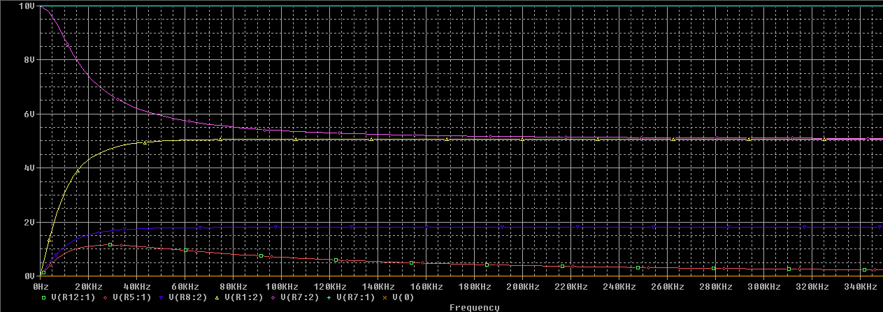
Simulation results after AC analysis of Test setup - 8

